Slide 1

Student Attendance Tracking
Group B - Code Green
Sirisha Vanamali
Rohith Babu sadhu
Sri Sai Ram Kumar Mamidala
Vamsi Devalla
Subba Reddy Pothireddy
Vipul Reddy Madadi
Shankar Rao Vallapurapu

Slide 2
Contents
Introduction
Project Briefing
Overview of the system
Requirements
Project Management Plan
Security
Prototypes
Challenges
Strategy
Estimation

Slide 3
Introduction
Develop a System which would help the professors easy to grade and track the students attendance.
Develop a system which could overcome all the litigations of the previous systems.
Instructor develops a unique QR for every class and students scan those QR to mark their attendance for that class.

Slide 4
Project Briefing
Three Users of the system
Instructor
Student
Admin
Additional Features
Students can view attendance for all courses registered
Feedback for the student and professor

Slide 5
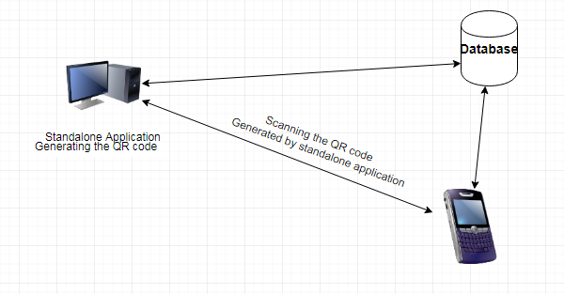
Overview of the System
Need some clarity on this and yet to include the software architecture

Slide 6
Requirements
Student Requirements:
Student must be able to Scan the QR code.
Must be able to capture the QR code.
Student should be able to view the courses he is registered and also be able to check his attendance percentage for the respective courses.
System should provide an acknowledge stating if the QR was scanned and attendance has been marked successfully.

Slide 7
Requirements (Contd…)
Instructor Requirements:
System should allow the instructor to generate the QR code.
Generate QR code uniquely every time the instructor asks for a QR code.
System should generate the QR based on the constraints such as
Course CRN
Time at which the course meet
System should allow the instructor to display any number of QR codes.
Display the Student details.

Slide 8
Requirements (Contd…)
Admin Requirements
Requirements of the admins are likely to be overlapping with the instructor
Admin has all the features similar to that of an instructor yet has an extra feature to view the details of the instructors and the students of that particular department.

Slide 9
Project Management Plan
Project Management Plan includes:
Scope Management Plan
Communication Management Plan
Cost management plan
Schedule management plan
Quality Management plan
Risk Management plan

Slide 10
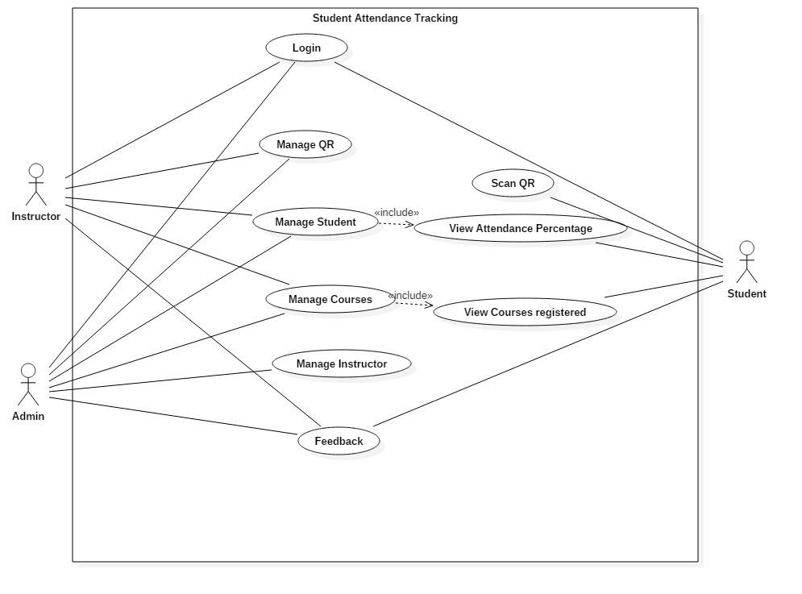
Use Case Diagram

Slide 11
Security
Student needs to login into his application before scanning the QR.
Time constraint to re-login into his account if once logged-out.
Capturing of the QR code ensures that the student is present at the time of scanning the QR.

Slide 12
Challenges
Generation of the Unique QR code for each time.
QR codes generated from two standalone applications are different.
Database that can connect cross platform applications for no cost.
Scanning and capturing QR code in a single functionality.

Slide 13
Strategy
Developing of a system which initially generates a QR code uniquely every time.
Scan the uniquely generated QR from a mobile device sending the details of the student scanned the QR to the professor.
Then finally work on the user interface.

Slide 14
Estimation
Our rough estimation is around 6000 lines of code
Equal distribution of tasks among team members.
Will complete the project by the end of 11 week of GDP 2.
About 5180 hours of combined team work in GDP 1 and 2.

Slide 15
Conclusion
Generating of the QR code and tracking the attendance of the students would help both the students and the instructor’s save the time.
This approach could be used by any institution for a better, flexible and an abuse free system.

Slide 16
Thank you

